Slide 1
STATISTICAL INFERENCE & RESEARCH

Slide 2
Inferential Statistics
Research is about trying to make valid inferences
Inferential statistics: the part of statistics that allows researchers to generalize their findings beyond data collected.
Statistical inference: a procedure for making inferences or generalizations about a larger population from a sample of that population

Slide 3
Lecture Parts
Weak Law of Large Numbers & Central Limit Theorem
Estimation Theory

Slide 4
Weak Law of Large Numbers & Central Limit Theorem

Slide 5

Pre - Poll / Election Survey

Slide 6

Markov’ Inequality
Consider any positive random variable X$∈(0,∞)$ with density $f_{X}\left(.\right)$

Slide 7

Markov’ Inequality
Consider any positive random variable X$∈(0,∞)$ with density $f_{X}\left(.\right)$
E(X) = $\int_{0}^{+∞}{x}$ $f_{X}$ (x) dx

Slide 8

Markov’ Inequality
Consider any positive random variable X$∈(0,∞)$ with density $f_{X}\left(.\right)$
E(X) = $\int_{0}^{+∞}{x}$ $f_{X}$ (x) dx ≥ $\int_{a}^{+∞}{x}$ $f_{X}$ (x) dx , where a > 0

Slide 9
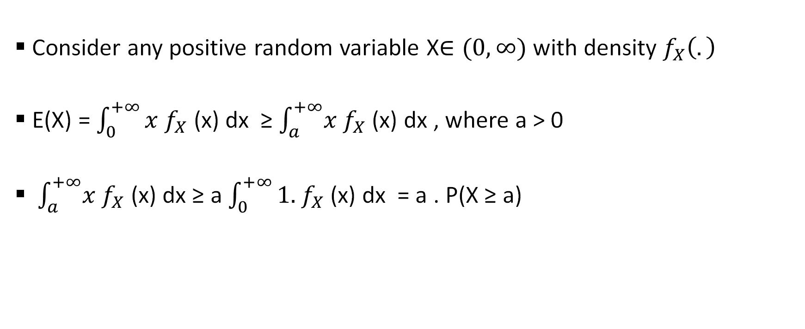
Markov’ Inequality
Consider any positive random variable X$∈(0,∞)$ with density $f_{X}\left(.\right)$
E(X) = $\int_{0}^{+∞}{x}$ $f_{X}$ (x) dx ≥ $\int_{a}^{+∞}{x}$ $f_{X}$ (x) dx , where a > 0
$\int_{a}^{+∞}{x}$ $f_{X}$ (x) dx ≥ a $\int_{0}^{+∞}{1.}$ $f_{X}$ (x) dx = a . P(X ≥ a)

Slide 10
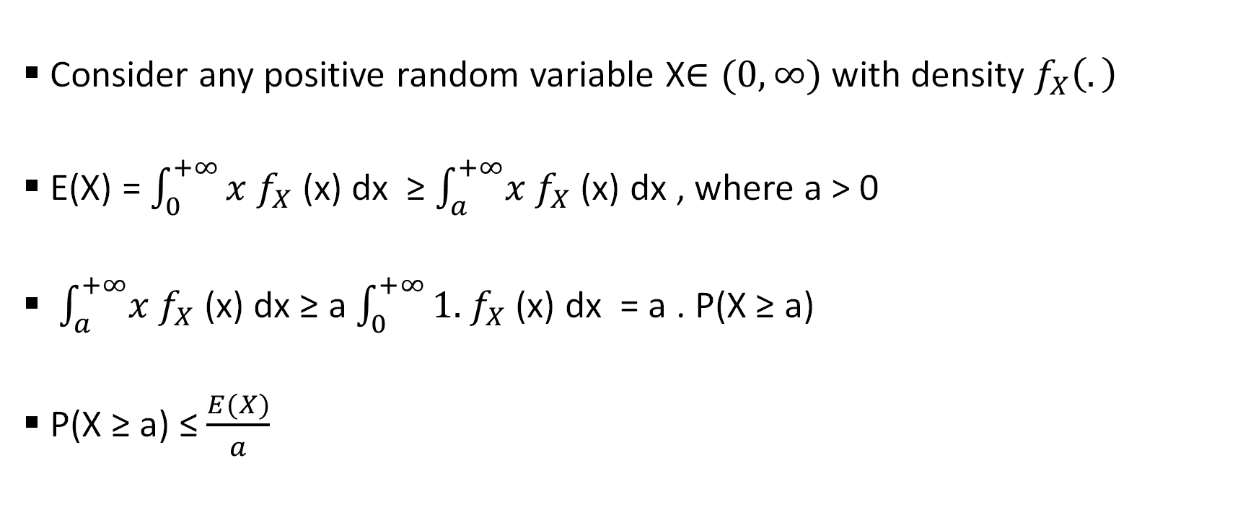
Markov’ Inequality
Consider any positive random variable X$∈(0,∞)$ with density $f_{X}\left(.\right)$
E(X) = $\int_{0}^{+∞}{x}$ $f_{X}$ (x) dx ≥ $\int_{a}^{+∞}{x}$ $f_{X}$ (x) dx , where a > 0
$\int_{a}^{+∞}{x}$ $f_{X}$ (x) dx ≥ a $\int_{0}^{+∞}{1.}$ $f_{X}$ (x) dx = a . P(X ≥ a)
P(X ≥ a) ≤ $\frac{E(X)}{a}$

Slide 11

Chebyshev’s Inequality
Consider any random variable X $\sim$ $F_{X}$ ($μ,σ^{2}$)

Slide 12

Chebyshev’s Inequality
Consider any random variable X $\sim$ $F_{X}$ ($μ,σ^{2}$)
Define Q = ${(X −μ)}^{2}$. Q is definitely a positive random variable.

Slide 13
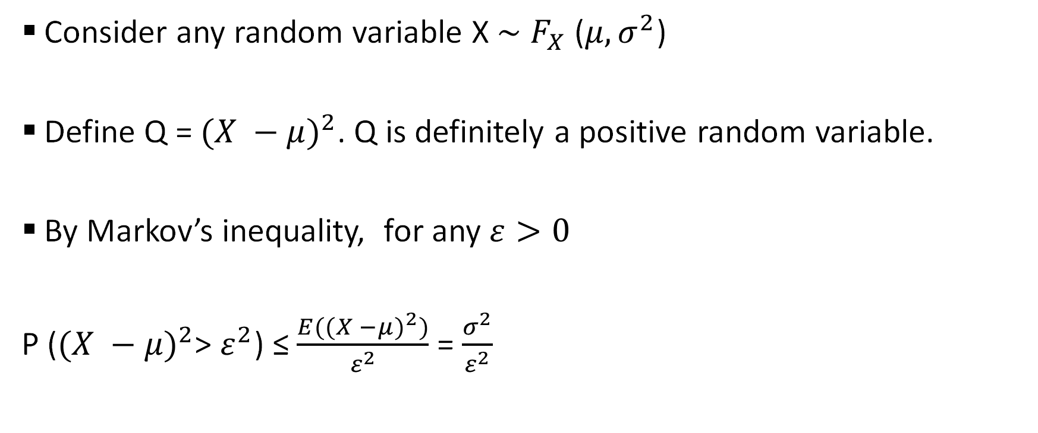
Chebyshev’s Inequality
Consider any random variable X $\sim$ $F_{X}$ ($μ,σ^{2}$)
Define Q = ${(X −μ)}^{2}$. Q is definitely a positive random variable.
By Markov’s inequality, for any $ε>0$
P (${(X −μ)}^{2}$> $ε^{2}$) ≤ $\frac{E({(X −μ)}^{2})}{ε^{2}}$ = $\frac{σ^{2}}{ε^{2}}$

Slide 14
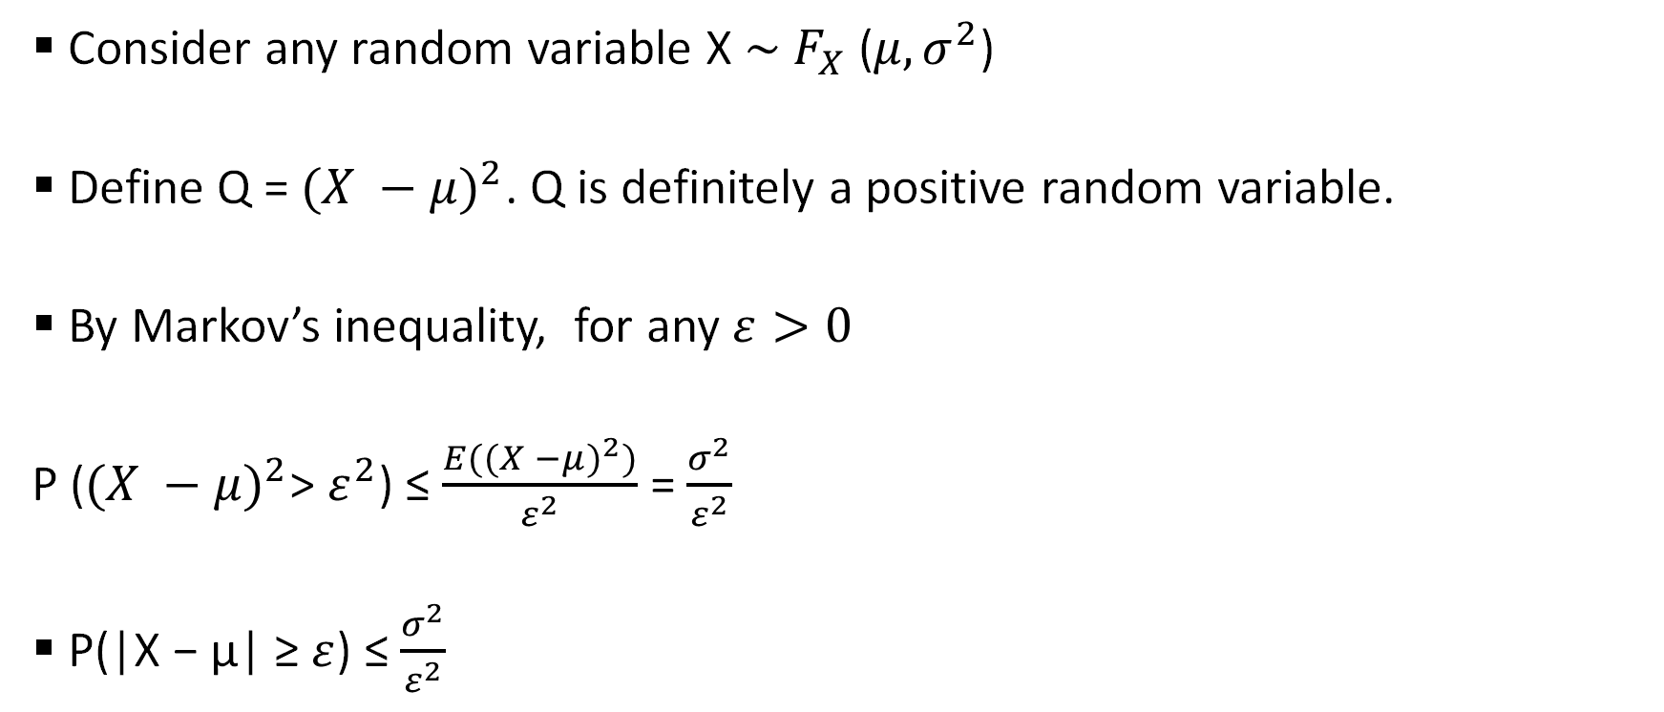
Chebyshev’s Inequality
Consider any random variable X $\sim$ $F_{X}$ ($μ,σ^{2}$)
Define Q = ${(X −μ)}^{2}$. Q is definitely a positive random variable.
By Markov’s inequality, for any $ε>0$
P (${(X −μ)}^{2}$> $ε^{2}$) ≤ $\frac{E({(X −μ)}^{2})}{ε^{2}}$ = $\frac{σ^{2}}{ε^{2}}$
P(|X − µ| ≥ $ε$) ≤ $\frac{σ^{2}}{ε^{2}}$

Slide 15

Weak Law of Large Numbers
$X_{1}$, $X_{2}$, $X_{3}$,…… $X_{n}$ are iid, where $X_{j}$ $\sim$ F ($μ,σ^{2}$) $∀ j=1,2,…..n$

Slide 16

Weak Law of Large Numbers
$X_{1}$, $X_{2}$, $X_{3}$,…… $X_{n}$ are iid, where $X_{j}$ $\sim$ F ($μ,σ^{2}$) $∀ j=1,2,…..n$
$M_{n}$ = $\frac{X_{1}{+ X}_{2}{+ X}_{3}….X_{n}}{n}$

Slide 17

Weak Law of Large Numbers
$X_{1}$, $X_{2}$, $X_{3}$,…… $X_{n}$ are iid, where $X_{j}$ $\sim$ F ($μ,σ^{2}$) $∀ j=1,2,…..n$
$M_{n}$ = $\frac{X_{1}{+ X}_{2}{+ X}_{3}….X_{n}}{n}$
What happens if n -> $∞$ ?

Slide 18

Convergence in Probability
E($M_{n}$ ) = $μ$ & V($M_{n}$) = $\frac{σ^{2}}{n}$

Slide 19

Convergence in Probability
E($M_{n}$ ) = $μ$ & V($M_{n}$) = $\frac{σ^{2}}{n}$
According to Chebyshev’s Inequality: For any finite $ε$ > 0
P(| $M_{n}$ − µ| ≥ $ε$) ≤ $\frac{\frac{σ^{2}}{n}}{ε^{2}}$ = $\frac{σ^{2}}{nε^{2}}$

Slide 20
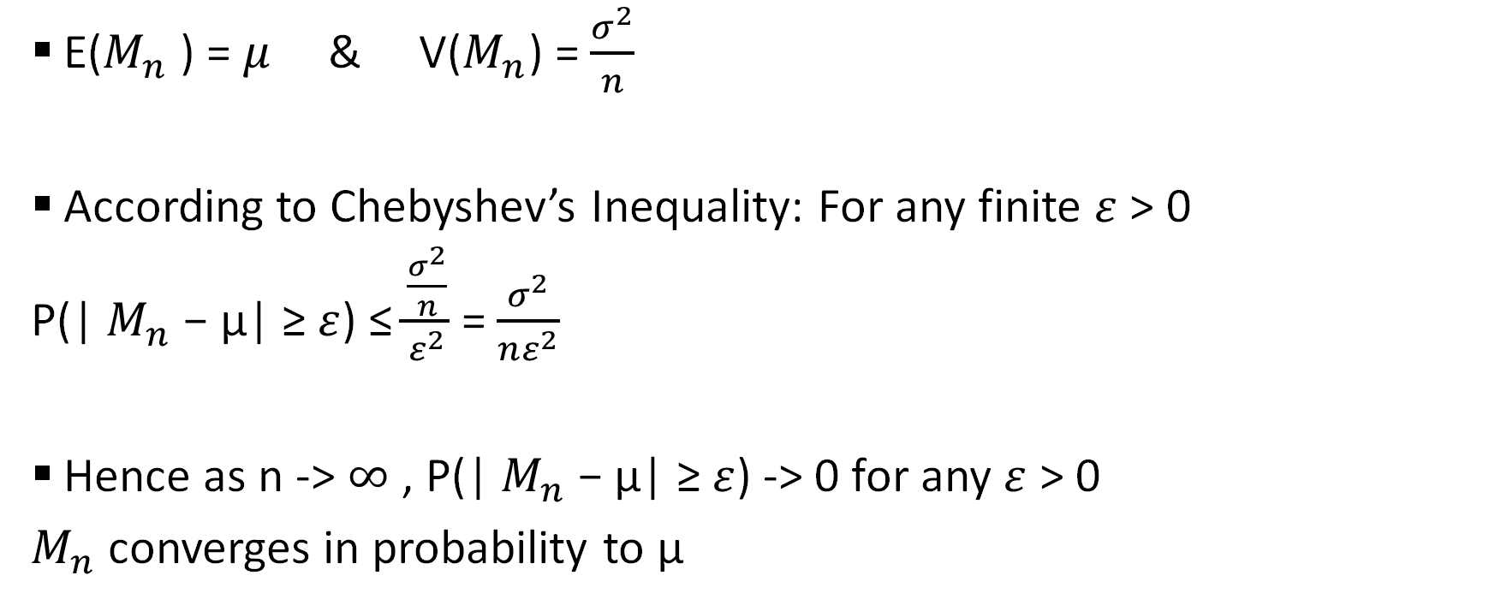
Convergence in Probability
E($M_{n}$ ) = $μ$ & V($M_{n}$) = $\frac{σ^{2}}{n}$
According to Chebyshev’s Inequality: For any finite $ε$ > 0
P(| $M_{n}$ − µ| ≥ $ε$) ≤ $\frac{\frac{σ^{2}}{n}}{ε^{2}}$ = $\frac{σ^{2}}{nε^{2}}$
Hence as n -> $∞$ , P(| $M_{n}$ − µ| ≥ $ε$) -> 0 for any $ε$ > 0
$M_{n}$ converges in probability to µ

Slide 21

Pre - Poll / Election Survey

Slide 22
The Methodology
f: The proportion of people respond “voting for Republicans”

Slide 23
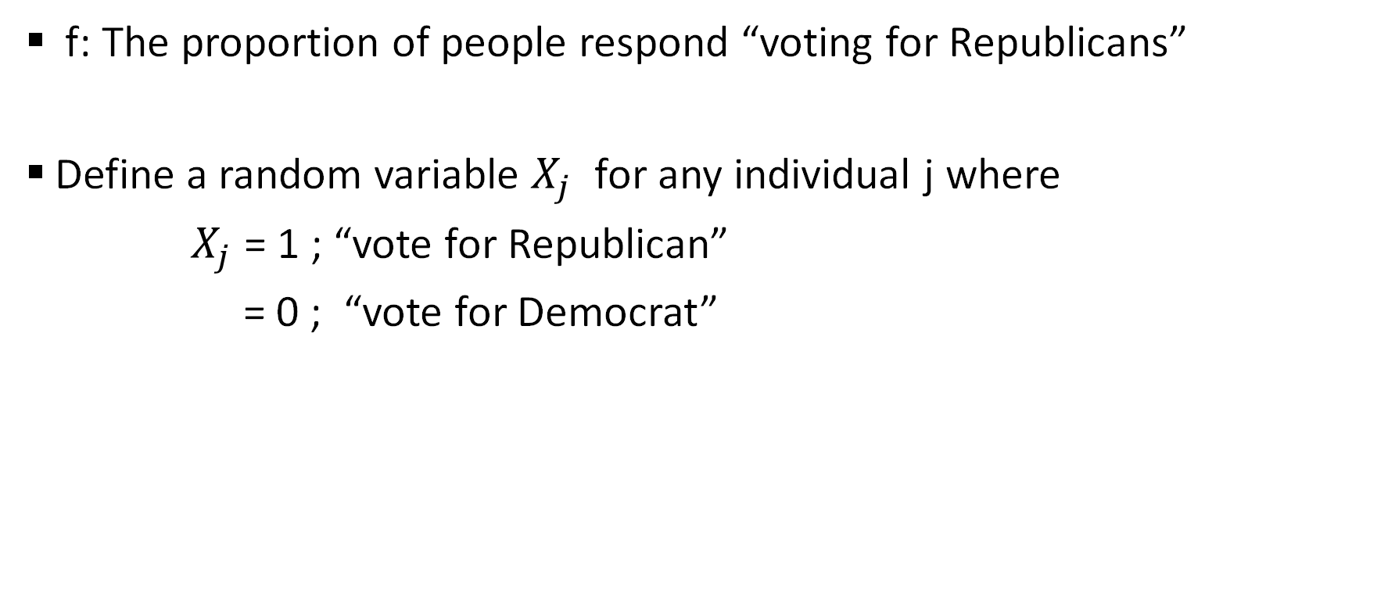
The Methodology
f: The proportion of people respond “voting for Republicans”
Define a random variable $X_{j}$ for any individual j where
$X_{j}$ = 1 ; “vote for Republican”
= 0 ; “vote for Democrat”

Slide 24
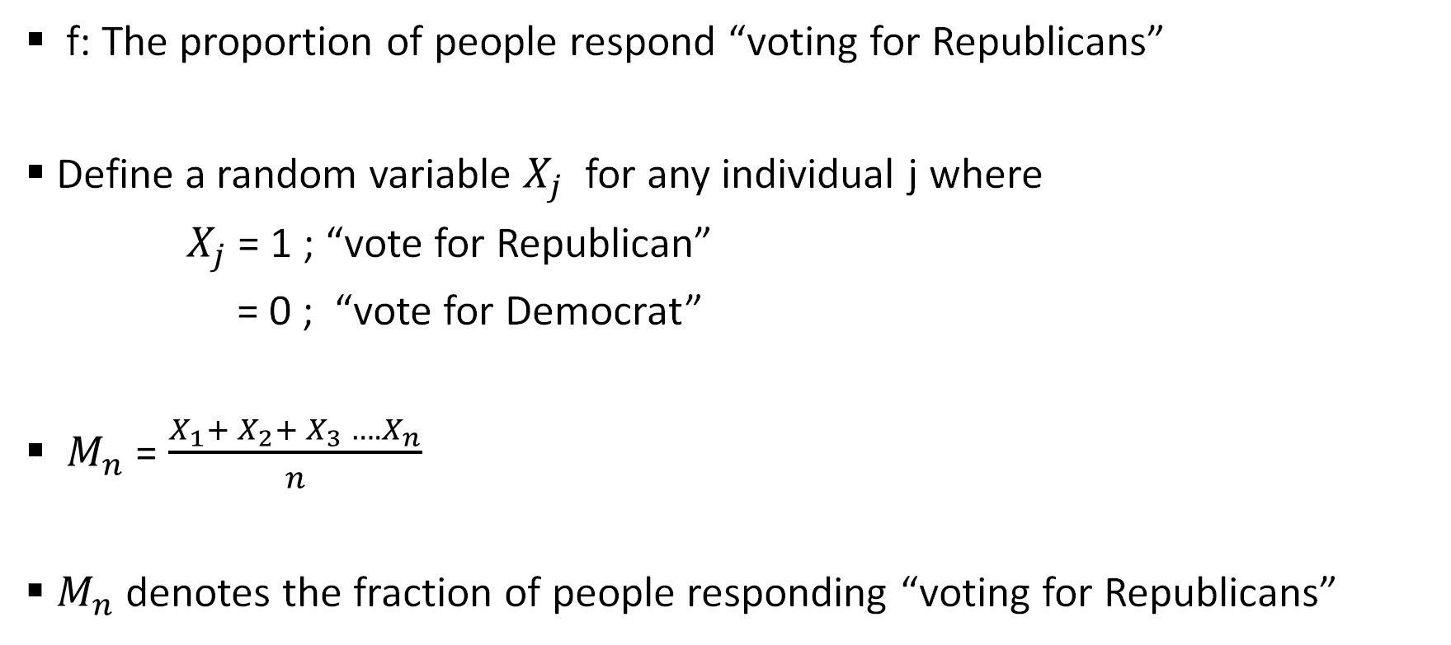
The Methodology
f: The proportion of people respond “voting for Republicans”
Define a random variable $X_{j}$ for any individual j where
$X_{j}$ = 1 ; “vote for Republican”
= 0 ; “vote for Democrat”
$M_{n}$ = $\frac{X_{1}{+ X}_{2}{+ X}_{3}….X_{n}}{n}$
$M_{n}$ denotes the fraction of people responding “voting for Republicans”

Slide 25
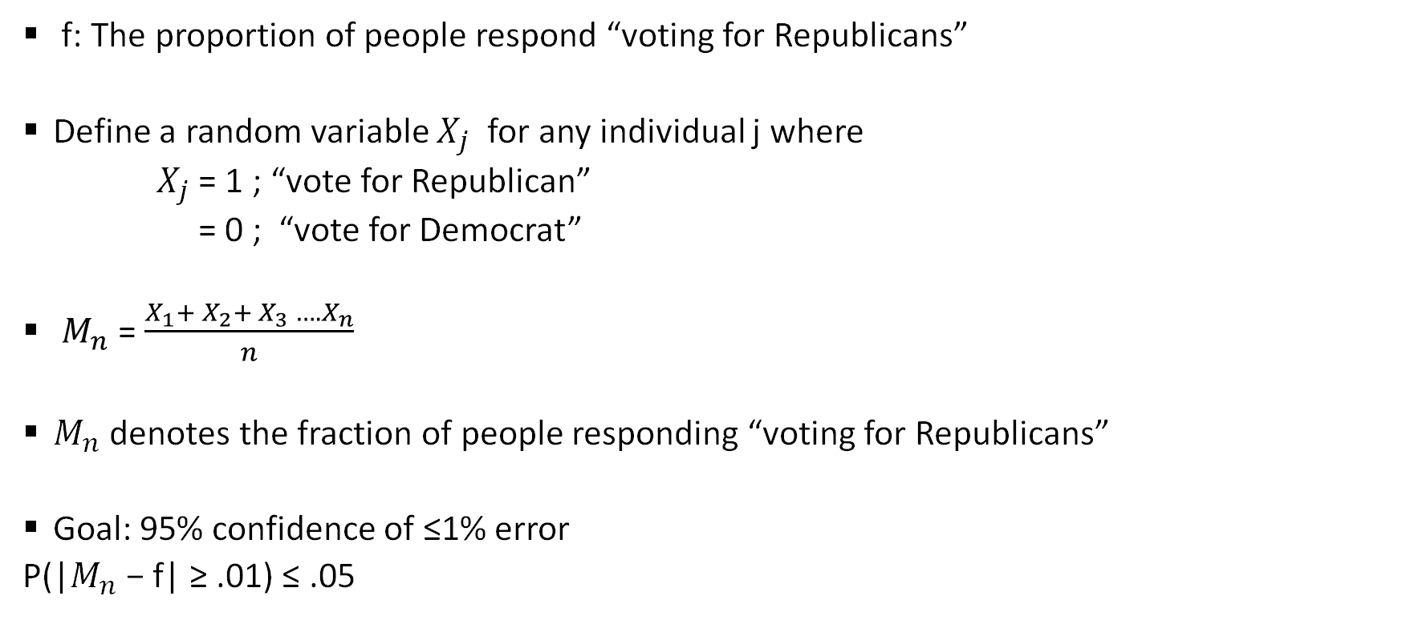
The Methodology
f: The proportion of people respond “voting for Republicans”
Define a random variable $X_{j}$ for any individual j where
$X_{j}$ = 1 ; “vote for Republican”
= 0 ; “vote for Democrat”
$M_{n}$ = $\frac{X_{1}{+ X}_{2}{+ X}_{3}….X_{n}}{n}$
$M_{n}$ denotes the fraction of people responding “voting for Republicans”
Goal: 95% confidence of ≤1% error
P(|$M_{n}$ − f| ≥ .01) ≤ .05

Slide 26

$X_{j}$ $\sim$ Ber (f)

Slide 27

$X_{j}$ $\sim$ Ber (f)
E($X_{j})$ = f & V($X_{j})$ = f(1-f)

Slide 28

$X_{j}$ $\sim$ Ber (f)
E($X_{j})$ = f & V($X_{j})$ = f(1-f)
$M_{n}$ = $\frac{X_{1}{+ X}_{2}{+ X}_{3}….X_{n}}{n}$

Slide 29

$X_{j}$ $\sim$ Ber (f)
E($X_{j})$ = f & V($X_{j})$ = f(1-f)
$M_{n}$ = $\frac{X_{1}{+ X}_{2}{+ X}_{3}….X_{n}}{n}$
E($M_{n}$) = f & V($M_{n})$ = $\frac{f(1−f)}{n}$

Slide 30

Using Chebyshev’s Inequality
P(|$M_{n}$ − f| ≥ .01) ≤ $\frac{\text{V}\text{(}M_{n})}{{(.01)}^{2}}$

Slide 31

Using Chebyshev’s Inequality
P(|$M_{n}$ − f| ≥ .01) ≤ $\frac{\text{V}\text{(}M_{n})}{{(.01)}^{2}}$ = $\frac{\frac{f(1−f)}{n}}{{(.01)}^{2}}$

Slide 32

Using Chebyshev’s Inequality
P(|$M_{n}$ − f| ≥ .01) ≤ $\frac{\text{V}\text{(}M_{n})}{{(.01)}^{2}}$ = $\frac{\frac{f(1−f)}{n}}{{(.01)}^{2}}$
We want $\frac{\frac{f(1−f)}{n}}{{(.01)}^{2}}$ < 0.05

Slide 33

We want $\frac{\frac{f(1−f)}{n}}{{(.01)}^{2}}$ < 0.05
Choose the sample size (n) such that $\frac{\frac{f(1−f)}{n}}{{(.01)}^{2}}$ < 0.05

Slide 34

We want $\frac{\frac{f(1−f)}{n}}{{(.01)}^{2}}$ < 0.05
Choose the sample size (n) such that $\frac{\frac{f(1−f)}{n}}{{(.01)}^{2}}$ < 0.05
But we don’t know f
In fact we are trying to find / estimate f.

Slide 35


Slide 36

f $∈\left[0,1\right] \& f\left(1−f\right)\text{≤}$ ¼

Slide 37

f $∈\left[0,1\right] \& f\left(1−f\right)\text{≤}$ ¼
Therefore $\frac{\frac{f(1−f)}{n}}{{(.01)}^{2}}$ $\text{≤}$ $\frac{1}{4n{(.01)}^{2}}$

Slide 38

f $∈\left[0,1\right] \& f\left(1−f\right)\text{≤}$ ¼
Therefore $\frac{\frac{f(1−f)}{n}}{{(.01)}^{2}}$ $\text{≤}$ $\frac{1}{4n{(.01)}^{2}}$
Now $\frac{1}{4n{(.01)}^{2}}$ < 0.05 if n ≥ 50000

Slide 39

f $∈\left[0,1\right] \& f\left(1−f\right)\text{≤}$ ¼
Therefore $\frac{\frac{f(1−f)}{n}}{{(.01)}^{2}}$ $\text{≤}$ $\frac{1}{4n{(.01)}^{2}}$
Now $\frac{1}{4n{(.01)}^{2}}$ < 0.05 if n ≥ 50000
So the minimum sample size (n) = 50000 !!!!

Slide 40


Slide 41

Central Limit Theorem
$X_{1}$, $X_{2}$, $X_{3}$,…… $X_{n}$ are iid, where $X_{j}$ $\sim$ F ($μ,σ^{2}$) $∀ j=1,2,…..n$
E($X_{j})$ = $μ$ & V($X_{j})$ =$σ^{2}$ $∀ j=1,2,…..n$

Slide 42

Central Limit Theorem
$X_{1}$, $X_{2}$, $X_{3}$,…… $X_{n}$ are iid, where $X_{j}$ $\sim$ F ($μ,σ^{2}$) $∀ j=1,2,…..n$
E($X_{j})$ = $μ$ & V($X_{j})$ =$σ^{2}$ $∀ j=1,2,…..n$
${S_{n}= X}_{1}{+ X}_{2}{+ X}_{3}….X_{n}$

Slide 43

Central Limit Theorem
$X_{1}$, $X_{2}$, $X_{3}$,…… $X_{n}$ are iid, where $X_{j}$ $\sim$ F ($μ,σ^{2}$) $∀ j=1,2,…..n$
E($X_{j})$ = $μ$ & V($X_{j})$ =$σ^{2}$ $∀ j=1,2,…..n$
${S_{n}= X}_{1}{+ X}_{2}{+ X}_{3}….X_{n}$
E($S_{n}$) = n$μ$ & V($S_{n}$) = n $σ^{2}$

Slide 44
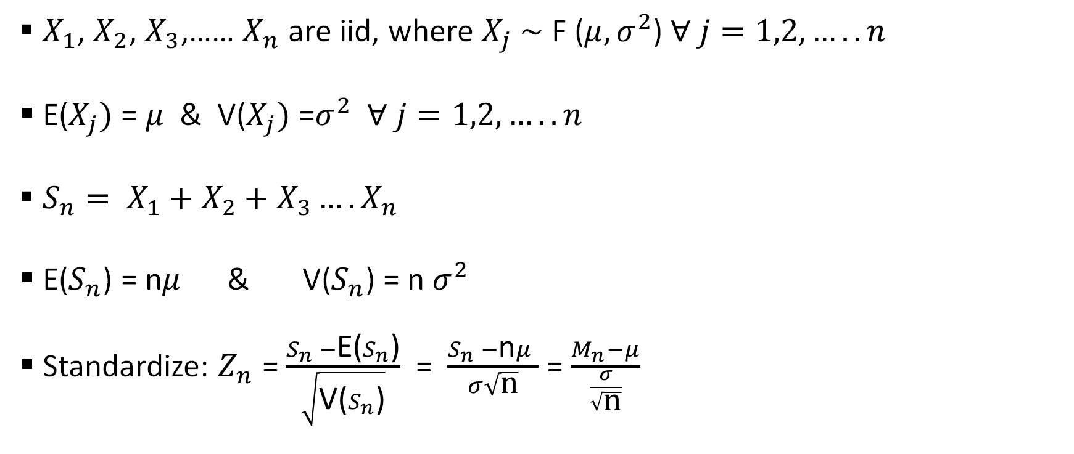
Central Limit Theorem
$X_{1}$, $X_{2}$, $X_{3}$,…… $X_{n}$ are iid, where $X_{j}$ $\sim$ F ($μ,σ^{2}$) $∀ j=1,2,…..n$
E($X_{j})$ = $μ$ & V($X_{j})$ =$σ^{2}$ $∀ j=1,2,…..n$
${S_{n}= X}_{1}{+ X}_{2}{+ X}_{3}….X_{n}$
E($S_{n}$) = n$μ$ & V($S_{n}$) = n $σ^{2}$
Standardize: $Z_{n}$ = $\frac{S_{n} −\text{E}\text{(}S_{n}\text{)}}{\sqrt{\text{V}\text{(}S_{n}\text{)}}}$ = $\frac{S_{n} −\text{n}μ }{σ\sqrt{\text{n}}}$ = $\frac{M_{n}−μ}{\frac{σ}{\sqrt{\text{n}}}}$

Slide 45

E($Z_{n}$ ) = 0 & V($Z_{n}$ ) = 1

Slide 46

E($Z_{n}$ ) = 0 & V($Z_{n}$ ) = 1
Let Z be a standard Normal random variable. i.e Z $\sim N\left(0,1\right)$

Slide 47
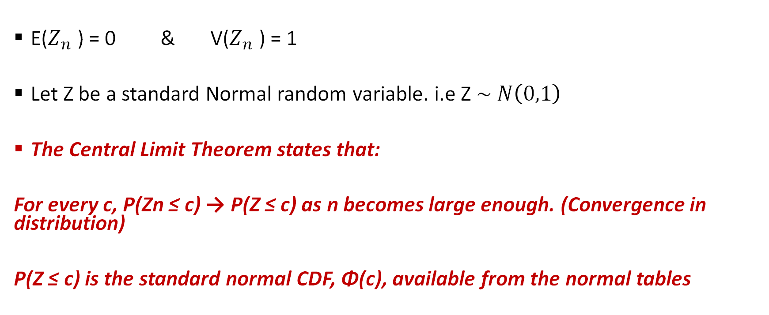
E($Z_{n}$ ) = 0 & V($Z_{n}$ ) = 1
Let Z be a standard Normal random variable. i.e Z $\sim N\left(0,1\right)$
The Central Limit Theorem states that:
For every c, P(Zn ≤ c) → P(Z ≤ c) as n becomes large enough. (Convergence in distribution)
P(Z ≤ c) is the standard normal CDF, Φ(c), available from the normal tables

Slide 48

Election problem – (with CLT)
E($M_{n}$) = f & V($M_{n})$ = $\frac{f(1−f)}{n}$

Slide 49

Election problem – (with CLT)
E($M_{n}$) = f & V($M_{n})$ = $\frac{f(1−f)}{n}$
Now we want P(|$M_{n}$ − f| ≥ .01) ≤ .05

Slide 50

Election problem – (with CLT)
E($M_{n}$) = f & V($M_{n})$ = $\frac{f(1−f)}{n}$
Now we want P(|$M_{n}$ − f| ≥ .01) ≤ .05
P(|$\frac{M_{n}\text{ − }\text{f}}{\sqrt{\frac{f(1−f)}{n}}}$| ≥ $\frac{.01}{\sqrt{\frac{f(1−f)}{n}}}$ ) ≤ .05

Slide 51

Election problem – (with CLT)
E($M_{n}$) = f & V($M_{n})$ = $\frac{f(1−f)}{n}$
Now we want P(|$M_{n}$ − f| ≥ .01) ≤ .05
P(|$\frac{M_{n}\text{ − }\text{f}}{\sqrt{\frac{f(1−f)}{n}}}$| ≥ $\frac{.01}{\sqrt{\frac{f(1−f)}{n}}}$ ) ≤ .05
P(|Z| ≥ $\frac{.01}{\sqrt{\frac{f(1−f)}{n}}}$ ) ≤ .05

Slide 52
f $∈\left[0,1\right] \& f\left(1−f\right)\text{≤}$ ¼

Slide 53

f $∈\left[0,1\right] \& f\left(1−f\right)\text{≤}$ ¼ => $\sqrt{f\left(1−f\right)}$ $\text{≤}$ ½

Slide 54

f $∈\left[0,1\right] \& f\left(1−f\right)\text{≤}$ ¼ => $\sqrt{f\left(1−f\right)}$ $\text{≤}$ ½
$\frac{.01}{\sqrt{\frac{f(1−f)}{n}}}$ ≥ $\frac{.01 \sqrt{n}}{\frac{1}{2}}$ = $.02 \sqrt{n}$

Slide 55

f $∈\left[0,1\right] \& f\left(1−f\right)\text{≤}$ ¼ => $\sqrt{f\left(1−f\right)}$ $\text{≤}$ ½
$\frac{.01}{\sqrt{\frac{f(1−f)}{n}}}$ ≥ $\frac{.01 \sqrt{n}}{\frac{1}{2}}$ = $.02 \sqrt{n}$
P(|Z| ≥ $\frac{.01}{\sqrt{\frac{f(1−f)}{n}}}$ ) ≤ P(|Z| ≥ $.02 \sqrt{n}$)

Slide 56

If n = 10000, P(|Z| ≥ $.02 \sqrt{n}$) = P(|Z| ≥ $2$) < .05

Slide 57

If n = 10000, P(|Z| ≥ $.02 \sqrt{n}$) = P(|Z| ≥ $2$) < .05
In fact P(|Z| ≥ $.02 \sqrt{n}$) = .05 implies $.02 \sqrt{n}$ = 1.96 i.e n = 9604.

Slide 58

If n = 10000, P(|Z| ≥ $.02 \sqrt{n}$) = P(|Z| ≥ $2$) < .05
In fact P(|Z| ≥ $.02 \sqrt{n}$) = .05 implies $.02 \sqrt{n}$ = 1.96 i.e n = 9604.
And 9604 << 50000 !!!!!

Slide 59


Slide 60
ESTIMATION

Slide 61
Estimation - categories
Point Estimation
Interval estimation

Slide 62
Point Estimation
The Statistic
The desirable properties of an estimator:
Unbiasedness
Consistency

Slide 63
Interval Estimation
Interval Estimation: an inferential statistical procedure used to estimate population parameters from sample data through the building of confidence intervals
Confidence Intervals: a range of values computed from sample data that has a known probability of capturing some population parameter of interest

Slide 64
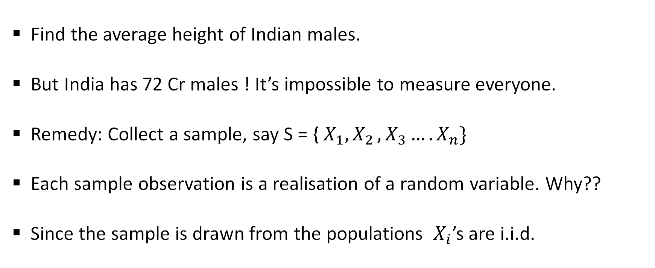
The Problem Statement
Find the average height of Indian males.
But India has 72 Cr males ! It’s impossible to measure everyone.
Remedy: Collect a sample, say S = {${ X}_{1}{, X}_{2}{, X}_{3}….X_{n}\}$
Each sample observation is a realisation of a random variable. Why??
Since the sample is drawn from the populations ${ X}_{i}$’s are i.i.d.

Slide 65
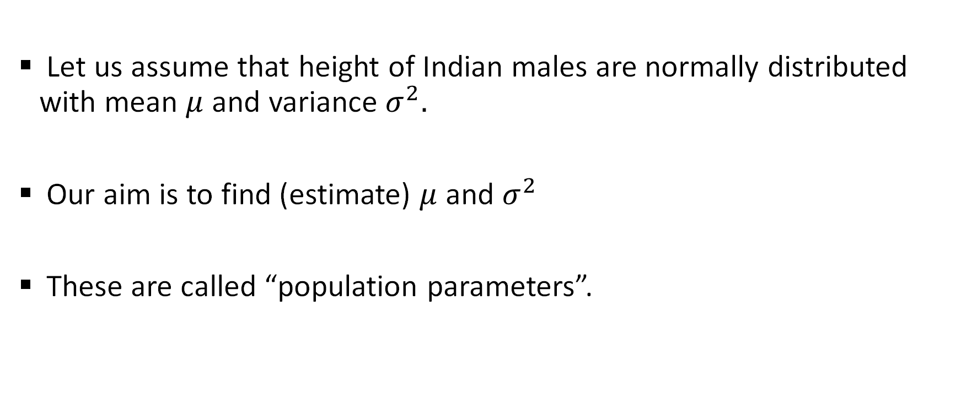
The Assumption
Let us assume that height of Indian males are normally distributed with mean $μ$ and variance $σ^{2}.$
Our aim is to find (estimate) $μ$ and $σ^{2}$
These are called “population parameters”.

Slide 66

Sample Statistics
Sample mean $\overline{X}$ = $\frac{1}{n} \sum_{i=1}^{n}{X_{i}}$
Sample variance $s^{2}$ = $\frac{1}{n} \sum_{i=1}^{n}{{(X_{i} −\overline{X})}^{2}}$

Slide 67

Sample Statistics
Sample mean $\overline{X}$ = $\frac{1}{n} \sum_{i=1}^{n}{X_{i}}$
Sample variance $s^{2}$ = $\frac{1}{n} \sum_{i=1}^{n}{{(X_{i} −\overline{X})}^{2}}$
I would want to use the sample statistics to “estimate” the population parameters.
Let’s see how.

Slide 68

Point Estimation
Just take the sample mean ($\overline{X}$) and sample variance ($s^{2}$) as proxies for the population mean $(μ)$ and population variance ${(σ}^{2}$), respectively.
$\overline{X}$ and $s^{2}$ are called point estimators of $μ$ and $σ^{2}$ respectively.
But are they “good” proxies?

Slide 70
The “Good” Properties
The good / desirable properties of a point estimator are
Unbiasedness
Consistency

Slide 71

The “Good” Properties
The good / desirable properties of a point estimator are
Unbiasedness:
E($\overline{X}$) = $μ$
E($s^{2}$) = $σ^{2}$
ii. Consistency

Slide 72

The “Good” Properties
The good / desirable properties of a point estimator are
Unbiasedness:
E($\overline{X}$) = $μ$
E($s^{2}$) = $σ^{2}$
Consistency:
$\lim_{n→ ∞}{V}$($\overline{X}$) = 0
$\lim_{n→ ∞}{V}$($s^{2}$) = 0

Slide 73

Interval estimation of mean
Sample observations S = {${ X}_{1}{, X}_{2}{, X}_{3}….X_{n}\}$

Slide 74

Interval estimation of mean
Sample observations S = {${ X}_{1}{, X}_{2}{, X}_{3}….X_{n}\}$
${ X}_{i}$ $\sim$N ($μ$, $σ^{2}$)

Slide 75

Interval estimation of mean
Sample observations S = {${ X}_{1}{, X}_{2}{, X}_{3}….X_{n}\}$
${ X}_{i}$ $\sim$N ($μ$, $σ^{2}$)
$\overline{X}$ = $\frac{1}{n} \sum_{i=1}^{n}{X_{i}}$

Slide 76

Interval estimation of mean
Sample observations S = {${ X}_{1}{, X}_{2}{, X}_{3}….X_{n}\}$
${ X}_{i}$ $\sim$N ($μ$, $σ^{2}$)
$\overline{X}$ = $\frac{1}{n} \sum_{i=1}^{n}{X_{i}}$
$\overline{X}$ $\sim$N ($μ$, $\frac{σ^{2}}{n}$)

Slide 77

Interval estimation of mean
Sample observations S = {${ X}_{1}{, X}_{2}{, X}_{3}….X_{n}\}$
${ X}_{i}$ $\sim$N ($μ$, $σ^{2}$)
$\overline{X}$ = $\frac{1}{n} \sum_{i=1}^{n}{X_{i}}$
$\overline{X}$ $\sim$N ($μ$, $\frac{σ^{2}}{n}$)
Z = $\frac{\overline{X} −μ}{\frac{σ}{\sqrt{n}}}$ $\sim$N ($0$,1)

Slide 78

The Standard Normal Distribution

Slide 79

The Interval
P($\left|Z\right|<\left|Z_{α/2}\right|$) = 1 - $α$

Slide 80

The Interval
P($\left|Z\right|<\left|Z_{α/2}\right|$) = 1 - $α$
P(- $Z_{α/2}$ < Z < $Z_{α/2}$) = 1 - $α$

Slide 81

The Interval
P($\left|Z\right|<\left|Z_{α/2}\right|$) = 1 - $α$
P(- $Z_{α/2}$ < Z < $Z_{α/2}$) = 1 - $α$
P(- $Z_{α/2}$ < $\frac{\overline{X} −μ}{\frac{σ}{\sqrt{n}}}$ < $Z_{α/2}$) = 1 - $α$

Slide 82

The Interval
P($\left|Z\right|<\left|Z_{α/2}\right|$) = 1 - $α$
P(- $Z_{α/2}$ < Z < $Z_{α/2}$) = 1 - $α$
P(- $Z_{α/2}$ < $\frac{\overline{X} −μ}{\frac{σ}{\sqrt{n}}}$ < $Z_{α/2}$) = 1 - $α$
P($μ$ $∈(\overline{X} −\frac{σ}{\sqrt{n}} .Z_{\frac{α}{2}} ,\overline{X}+\frac{σ}{\sqrt{n}} .Z_{\frac{α}{2}})$ = 1 - $α$

Slide 83

The Interval
P($\left|Z\right|<\left|Z_{α/2}\right|$) = 1 - $α$
P(- $Z_{α/2}$ < Z < $Z_{α/2}$) = 1 - $α$
P(- $Z_{α/2}$ < $\frac{\overline{X} −μ}{\frac{σ}{\sqrt{n}}}$ < $Z_{α/2}$) = 1 - $α$
P($μ$ $∈(\overline{X} −\frac{σ}{\sqrt{n}} .Z_{\frac{α}{2}} ,\overline{X}+\frac{σ}{\sqrt{n}} .Z_{\frac{α}{2}})$ = 1 - $α$
This is the interval within which $μ$ lies with probability = 1 - $α$
We can compute $\overline{X}$ from the sample. n is the sample size. $Z_{α/2}$ can be computed from the standard normal table. So if we know $σ$, we are done !!

Slide 84

We may not know $σ$ !!

Slide 85

The t - statistic
$\frac{\left(n−1\right).s^{2}}{σ^{2}}\sim$ ${\text{χ}}_{(n−1)}^{2}$

Slide 86

The t - statistic
$\frac{\left(n−1\right).s^{2}}{σ^{2}}\sim$ ${\text{χ}}_{(n−1)}^{2}$
Define a statistic t = $\frac{\overline{X} −μ}{\frac{s}{\sqrt{n}}}$

Slide 87

The t - statistic
$\frac{\left(n−1\right).s^{2}}{σ^{2}}\sim$ ${\text{χ}}_{(n−1)}^{2}$
Define a statistic t = $\frac{\overline{X} −μ}{\frac{s}{\sqrt{n}}}$ = $\frac{\frac{\overline{X} −μ}{\frac{σ}{\sqrt{n}}}}{s/σ}$

Slide 88

The t - statistic
$\frac{\left(n−1\right).s^{2}}{σ^{2}}\sim$ ${\text{χ}}_{(n−1)}^{2}$
Define a statistic t = $\frac{\overline{X} −μ}{\frac{s}{\sqrt{n}}}$ = $\frac{\frac{\overline{X} −μ}{\frac{σ}{\sqrt{n}}}}{s/σ}$ = $\frac{\frac{\overline{X} −μ}{\frac{σ}{\sqrt{n}}}}{\sqrt{\frac{\left(n−1\right).s^{2}}{σ^{2}}. \frac{1}{n−1}}}$ = $\frac{Z}{\sqrt{. \frac{{\text{χ}}_{(n−1)}^{2}}{n−1}}}$ $\sim$ $t_{n−1}$

Slide 89

The t - statistic
$\frac{\left(n−1\right).s^{2}}{σ^{2}}\sim$ ${\text{χ}}_{(n−1)}^{2}$
Define a statistic t = $\frac{\overline{X} −μ}{\frac{s}{\sqrt{n}}}$ = $\frac{\frac{\overline{X} −μ}{\frac{σ}{\sqrt{n}}}}{s/σ}$ = $\frac{\frac{\overline{X} −μ}{\frac{σ}{\sqrt{n}}}}{\sqrt{\frac{\left(n−1\right).s^{2}}{σ^{2}}. \frac{1}{n−1}}}$ = $\frac{Z}{\sqrt{. \frac{{\text{χ}}_{(n−1)}^{2}}{n−1}}}$ $\sim$ $t_{n−1}$
i.e the student’s t – distribution with n-1 degrees of freedom.

Slide 90

Student’s t - distribution

Slide 91

The Interval
P($\left|t\right|<\left|t_{n−1}^{(α/2)}\right|$) = 1 - $α$

Slide 92

The Interval
P($\left|t\right|<\left|t_{n−1}^{(α/2)}\right|$) = 1 - $α$
P(-$t_{n−1}^{(α/2)}$< t <${ t}_{n−1}^{(α/2)}$) = 1 - $α$
P(-$t_{n−1}^{(α/2)}$< $\frac{\overline{X} −μ}{\frac{s}{\sqrt{n}}}$ <$t_{n−1}^{(α/2)}$) = 1 - $α$

Slide 93

The Interval
P($\left|t\right|<\left|t_{n−1}^{(α/2)}\right|$) = 1 - $α$
P(-$t_{n−1}^{(α/2)}$< t <${ t}_{n−1}^{(α/2)}$) = 1 - $α$
P(-$t_{n−1}^{(α/2)}$< $\frac{\overline{X} −μ}{\frac{s}{\sqrt{n}}}$ <$t_{n−1}^{(α/2)}$) = 1 - $α$
P($μ$ $∈(\overline{X} −\frac{s}{\sqrt{n}} .t_{n−1}^{(α/2)},\overline{X}+\frac{s}{\sqrt{n}} .t_{n−1}^{(α/2)})$ = 1 - $α$

Slide 94

The Interval
P($\left|t\right|<\left|t_{n−1}^{(α/2)}\right|$) = 1 - $α$
P(-$t_{n−1}^{(α/2)}$< t <${ t}_{n−1}^{(α/2)}$) = 1 - $α$
P(-$t_{n−1}^{(α/2)}$< $\frac{\overline{X} −μ}{\frac{s}{\sqrt{n}}}$ <$t_{n−1}^{(α/2)}$) = 1 - $α$
P($μ$ $∈(\overline{X} −\frac{s}{\sqrt{n}} .t_{n−1}^{(α/2)},\overline{X}+\frac{s}{\sqrt{n}} .t_{n−1}^{(α/2)})$ = 1 - $α$
This is the interval within which $μ$ lies with probability = (1 - $α$)
We can compute $\overline{X}$ from the sample. n is the sample size.$t_{n−1}^{(α/2)}$can be computed from the t - distribution table.

Slide 95


Interval estimation of Variance
$\frac{\left(n−1\right).s^{2}}{σ^{2}}\sim$ ${\text{χ}}_{(n−1)}^{2}$

Slide 96

P ( ${\text{χ}}^{2} _{n−1}^{(1−\frac{α}{2})}$< $\frac{\left(n−1\right).s^{2}}{σ^{2}}$ < ${\text{χ}}^{2} _{n−1}^{(\frac{α}{2})}$) = 1 - $α$
P ($σ^{2}$ $∈(\frac{\left(n−1\right).s^{2}}{{\text{χ}}^{2} _{n−1}^{(1−\frac{α}{2})}}$ , $\frac{\left(n−1\right).s^{2}}{{\text{χ}}^{2} _{n−1}^{\left(\frac{α}{2}\right)}}$ ) = 1 - $α$
Given a sample we can compute $s^{2}$ and we know n (sample size). We can
compute ${\text{χ}}^{2} _{n−1}^{(\frac{α}{2})}$ & ${\text{χ}}^{2} _{n−1}^{(1−\frac{α}{2})}$ from the chi – square distribution table.
Thus we have found the interval such that $σ^{2}$ lies in that interval with probability (1- $α )$

